Slide 1
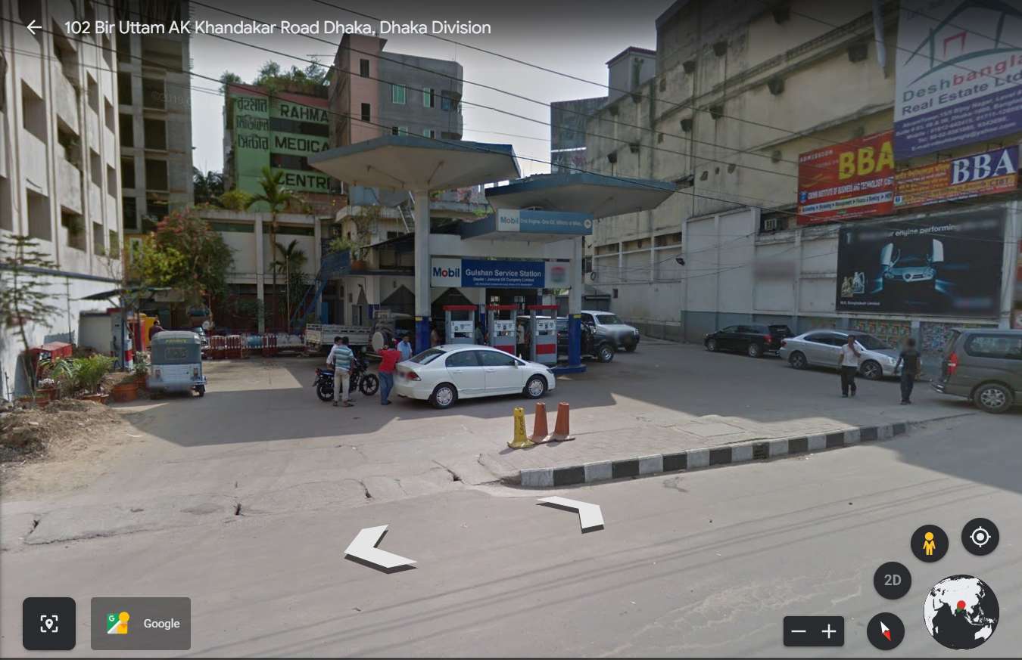

Slide 2
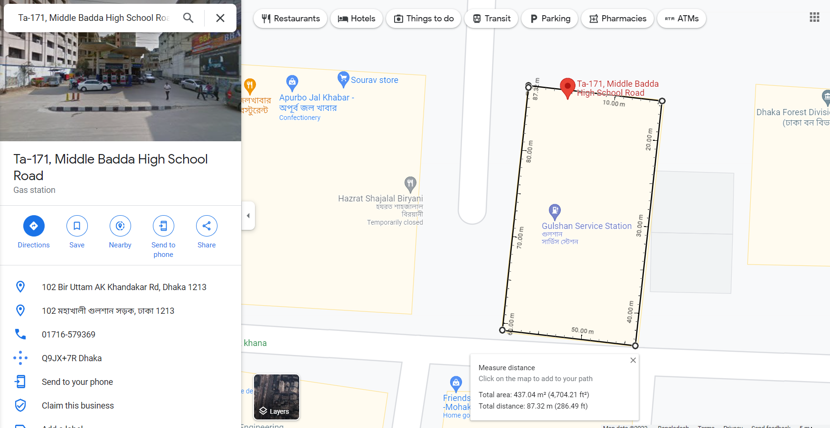

Slide 3
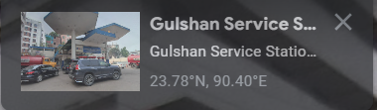
l = 23.78; % Gulshan Service Station
437.04 % area Gulshan Service Station m^2

Slide 4
AB = Area based monthly MWh 91.9563 89.3241 102.6951 100.6899 104.7499 102.5480 104.1541 101.7111 98.0150 97.9023 89.2342 88.8481 | zz = daily kwh/m^2 6.7873 7.2994 7.5800 7.6797 7.7316 7.8214 7.6876 7.5073 7.4757 7.2262 6.8060 6.5579 | yy = Monthly kwh/m^2 210.4070 204.3843 234.9787 230.3905 239.6803 234.6421 238.3171 232.7272 224.2701 224.0123 204.1787 203.2951

Slide 5
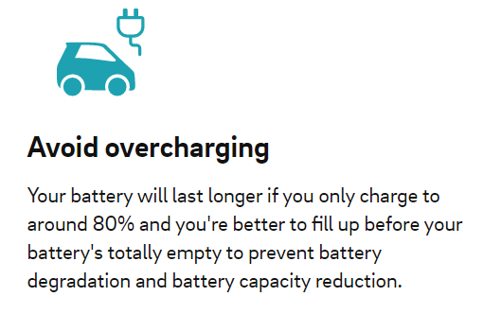
Load Calculation:
Type of EV | Small EV | Medium EV | Large EV | Light Commercial
Average Battery Size (right) Power Output (Below) | 25 kWh | 50 kWh | 75 kWh | 100 kWh
Level 1 2.3 kW | 10h30m | 24h30m | 32h45m | 43h30m
Level 2 7.4 kW | 3h45m | 7h45m | 10h00m | 13h30m
Level 2 11 kW | 2h00m | 5h15m | 6h45m | 9h00m
Level 2 22 kW | 1h00m | 3h00m | 4h30m | 6h00m
Level 3 50 kW | 36 min | 53 min | 1h20m | 1h48m
Level 3 120 kW | 11 min | 22 min | 33 min | 44 min
Level 3 150 kW | 10 min | 18 min | 27 min | 36 min
Level 3 240 kW | 6 min | 12 min | 17 min | 22 min
Per vehicle requires at least 480 Volts and 100 Amps current, so 48-50kw DC output capability required for at a time charging.
Level 1 (AC)
10h-40h
Level 2 (AC)
1h-20h
Level 3 (DC)
7min-2 h
https://evbox.com/en/ev-charging-guide#chapterfive
Electric car charging times
*Approximate time to charge the battery from 20 percent to 80 percent state of charge (SoC). For illustrative purposes only: Does not reflect exact charging times, some vehicles will not be able to handle certain power inputs and/or do not support fast charging.

Slide 6
https://dspace.bracu.ac.bd/xmlui/bitstream/handle/10361/16994/17121070%2c17121062%2c16321087%2c18121135_EEE.pdf?sequence=1&isAllowed=y
EV charging thesis reference
Currently available DC fast chargers require inputs of at least 480 volts and 100 amps,
https://calevip.org/electric-vehicle-charging-101#:~:text=Currently%20available%20DC%20fast%20chargers,(up%20to%20360%20kW).
zz =
Area based daily average.
(Mwh)
2.9663
3.1901
3.3127
3.3563
3.3790
3.4183
3.3598
3.2810
3.2672
3.1581
2.9745
2.8661
https://justenergy.com/blog/electric-vehicle-charging-stations/
DC fast charging stations are even more powerful, providing up to 480 volts of power and reducing charging times to less than an hour. Tesla claims that you can add 200 miles of range in 15 minutes at Supercharger stations.

Slide 7
Site Selection
Site Assessment based on accumulated cumulative solar energy and highest possible number of solar panel number estimation
Charging Station Level Selection and Required Load Estimation
Required Number of Battery Estimation based on Output Power of the charging station
PV array estimation based on Battery arrangement
Highest possible number full load charging required vehicle and highest possible run time at maximum output power per charging pole estimation

Slide 8
Utilization | 90%
Wiring eff | 98%
temperature corr | 90%
depth of discharge | 80%
PV aray degrad | 90%
Volt | 12
PV | 250
PV Vmax | 30.6
PV Imax | 8.17
BATT Ah | 150Ah
PV area | 1.6 | m^2
Total Land | 437.04 | m^2
Approx number of PV occupied | 273.15 | 273
Number of battery for voltage to supply 480V | 44.44444444 | 45 | (Utilization factor)
Number of PVseries to serve (594V = 13.2x45) | 22.00880352 | 22 | (PV aray degrad factor,wiring eff)
PV Parallal |  |  | 12.40909091 | 12
Total Number of PV | s | p
 | 22 | 12 | 264
PV | 250 | w | Batt voltage | 45
curr | 8.17 |  | Batt Ah | 120 | 80% depth
vol | 30.6 |  | Batt wh | 1440

Slide 9
 | insolation | 250 x 264 x insolation | temp corr | BTTERY CHARGE Ah | Number of Batt parr | ~ | Total Battery
jan | 6.7873 | 447961.8 | 403165.62 | 746.603 | 6.221691667 | 6 | 270
feb | 7.2994 | 481760.4 | 433584.36 | 802.934 | 6.691116667 | 6 | 270
mar | 7.58 | 500280 | 450252 | 833.8 | 6.948333333 | 6 | 270
apr | 7.6797 | 506860.2 | 456174.18 | 844.767 | 7.039725 | 7 | 315
may | 7.7316 | 510285.6 | 459257.04 | 850.476 | 7.0873 | 7 | 315
jun | 7.8214 | 516212.4 | 464591.16 | 860.354 | 7.169616667 | 7 | 315
jul | 7.6876 | 507381.6 | 456643.44 | 845.636 | 7.046966667 | 7 | 315
aug | 7.5073 | 495481.8 | 445933.62 | 825.803 | 6.881691667 | 6 | 270
sep | 7.4757 | 493396.2 | 444056.58 | 822.327 | 6.852725 | 6 | 270
oct | 7.2262 | 476929.2 | 429236.28 | 794.882 | 6.624016667 | 6 | 270
nov | 6.806 | 449196 | 404276.4 | 748.66 | 6.238833333 | 6 | 270
dec | 6.5579 | 432821.4 | 389539.26 | 721.369 | 6.011408333 | 6 | 270

Slide 10
Type of EV | Small EV | Medium EV | Large EV | Light Commercial
Average Battery Size (right) | 25 kWh | 50 kWh | 75 kWh | 100 kWh
Final Total Output kwh | Per pole kwh | Per pole Ah |  |  | Small EV | Medium EV | Large EV | Light Commercial
388.8 | 129.6 | 270 |  |  | 5.184 | 2.592 | 1.728 | 1.296
388.8 | 129.6 | 270 |  |  | 5.184 | 2.592 | 1.728 | 1.296
388.8 | 129.6 | 270 |  |  | 5.184 | 2.592 | 1.728 | 1.296
453.6 | 151.2 | 315 |  |  | 6.048 | 3.024 | 2.016 | 1.512
453.6 | 151.2 | 315 |  |  | 6.048 | 3.024 | 2.016 | 1.512
453.6 | 151.2 | 315 |  |  | 6.048 | 3.024 | 2.016 | 1.512
453.6 | 151.2 | 315 |  |  | 6.048 | 3.024 | 2.016 | 1.512
388.8 | 129.6 | 270 |  |  | 5.184 | 2.592 | 1.728 | 1.296
388.8 | 129.6 | 270 |  |  | 5.184 | 2.592 | 1.728 | 1.296
388.8 | 129.6 | 270 |  |  | 5.184 | 2.592 | 1.728 | 1.296
388.8 | 129.6 | 270 |  |  | 5.184 | 2.592 | 1.728 | 1.296
388.8 | 129.6 | 270 |  |  | 5.184 | 2.592 | 1.728 | 1.296

Slide 11
System Design
kw | A | v 480V
50 | 104.1666667
 | insolation | Per pole Ah | time decimal | Hh:mm
jan | 6.7873 | 270 | 2.591991706 | 2:35
feb | 7.2994 | 270 | 2.591991706 | 2:35
mar | 7.58 | 270 | 2.591991706 | 2:35
apr | 7.6797 | 315 | 3.023990323 | 3:01
may | 7.7316 | 315 | 3.023990323 | 3:01
jun | 7.8214 | 315 | 3.023990323 | 3:01
jul | 7.6876 | 315 | 3.023990323 | 3:01
aug | 7.5073 | 270 | 2.591991706 | 2:35
sep | 7.4757 | 270 | 2.591991706 | 2:35
oct | 7.2262 | 270 | 2.591991706 | 2:35
nov | 6.806 | 270 | 2.591991706 | 2:35
dec | 6.5579 | 270 | 2.591991706 | 2:35

Slide 12

Terminal Output:
Power: 66KW
Current: 98.04A
Voltage: 673.2V
Series 22
Parallel 12

Slide 13

Series 45
Terminal Output:
Voltage: 540V

Slide 14
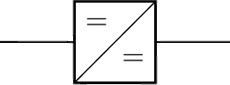
PV Array
Battery Array
Charging Pole
Solar Charge Controller
DC-DC Converter
Solar Array may Provide
12 * 8.17 = 98.04 Amp
22 * 30.6 = 673.2 V
66 KW output Power
Solar Charge Controller may Provide
45 * 13.2 = 594 V charging voltage
66KW / 594 V = 111 Amp charging current
Battery array can provide
45* 12 = 540 V
6 * 120 ~ 7*120; 720Ah ~ 840Ah charge capacity
Isolated DC-DC Converter system to each pole need to be designed
To supply 480V
At least 104A
Output Power 50 KW

Slide 15
Merits:
Green Energy
Charging station designed for RAPID/Fast charging, any Vehicle can charged up so faster than regular time.
Whole charging system covered with DC power system, therefore AC-DC conversion loss can be overcome significantly.
Though, every pole cannot charge many full capacity charge required vehicle, but it can play a vital role as an emergency charging station.
Mono-facial conventional standalone PV system has been assessed, by improving the design approach like, single axis control and improvising Bi-facial pv module might increase charging capability of the station significantly.
As a commercial project, the return of investment might be accumulated faster than the residential projects.

Slide 16
Limitations:
This system is designed for only 3 Vehicles charge at a time.
The Number of full load vehicle charging capability per day is not that much significant
Designed for only Level 3, DC source – DC load charging station.
The cost and size of the DC charging station are much higher than the AC charging station initially.
Calculative result estimated based on only clear day.
The efficiency factors are considered based on theoretical values and parameters

